Slide 1

AUTOMOTIVE TESTING

Slide 2

Contents
1
WHY TESTING?
2
ISO-26262
3
SOFTWARE TESTING
4
MECHANICAL TESTING
5
ELECTRONIC TESTING
6
TEAM MEMBERS

Slide 3

WHY TESTING?

Slide 4
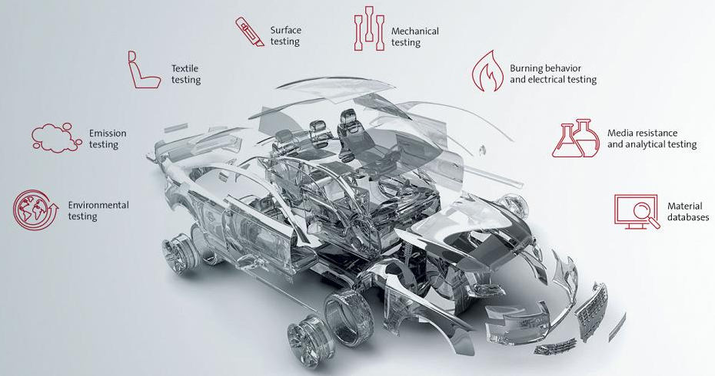


WHY TESTING?
Modern cars include many embedded systems.
To improve security & comfort.
Long lasting operation.
Brand Reputation.
User pays in huge bucks!
Image reference: Google Images

Slide 5
ISO 26262

Slide 6
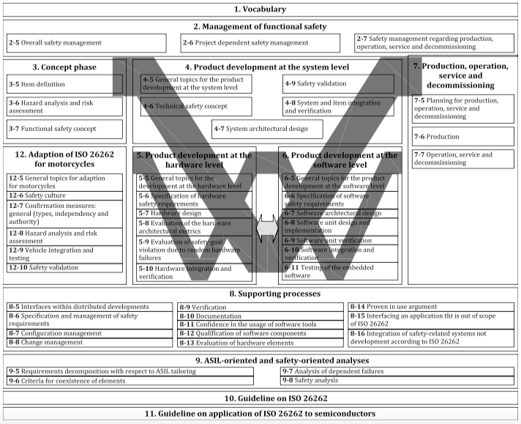
ISO-26262
Aka “Road vehicles – Functional safety”
International standard for functional safety of automobiles.
Ensures adequate safety measures are taken in a automotive project.
By complying with this, we can detect/control/avoid random failures.
Image reference: Google Images

Slide 7
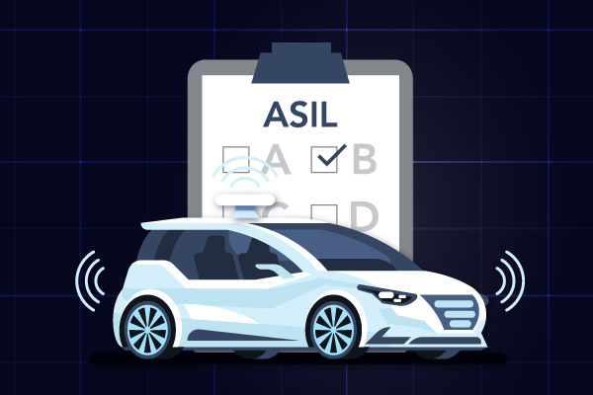
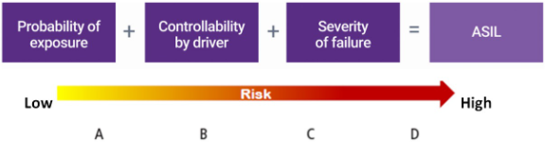
ASIL – Automotive Safety Integrity Level
Key component of ISO-26262.
Used to measure risk of specific component.
4 integrity levels: ASIL A,B,C&D.
3 factors determine ASIL:
Severity (S0-S3)
Exposure (E0-E4)
Controllability (C0-C3)
Based on these factors ASIL determined.
Image reference: Google Images

Slide 8
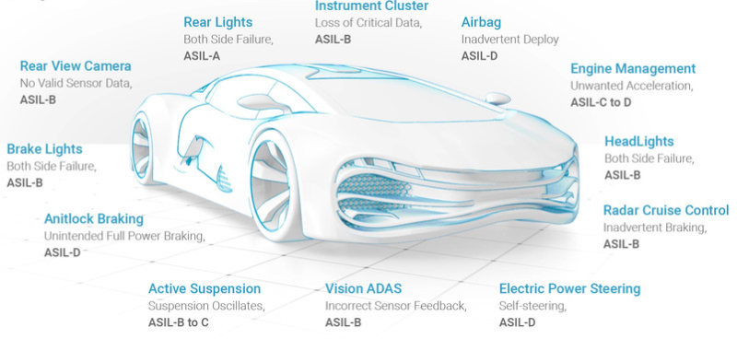
ASIL – Automotive Safety Integrity Level
Image reference: https://www.synopsys.com/automotive/what-is-asil.html

Slide 9
SOFTWARE TESTING

Slide 10
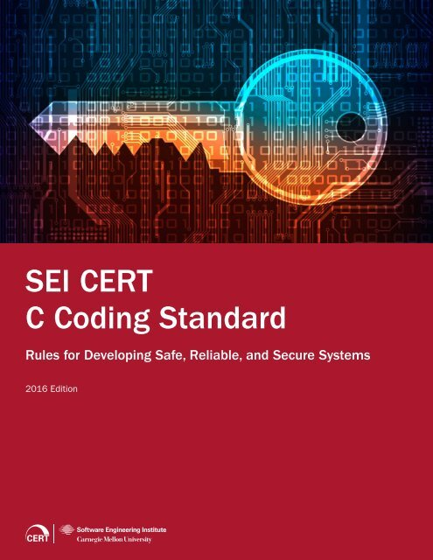

CODING STANDARDS
1) CERT: By Software Engineering Institute(SEI):-
In the CERT coding framework, priority is computed as a product of three factors and is divided into 3 levels:
L1: High Severity Violations
L2: Medium Severity Violations
L3: Low Severity Violations
Image reference: Google Images

Slide 11

CODING STANDARDS
2) MISRA C:-
MISRA C is a set of software development guidelines for the C programming language developed by MISRA (Motor Industry Software Reliability Association).
Image reference: Google Images

Slide 12


CODING STANDARDS
3)AUTOSAR: AUTomotive Open System ARchitecture:-
AUTOSAR is a partnership of automotive manufacturers, automotive suppliers, semiconductor vendors and tool vendors.
It supports standardization in interfaces between application software and basic vehicular functions.

Slide 13
MECHANICAL TESTING

Slide 14
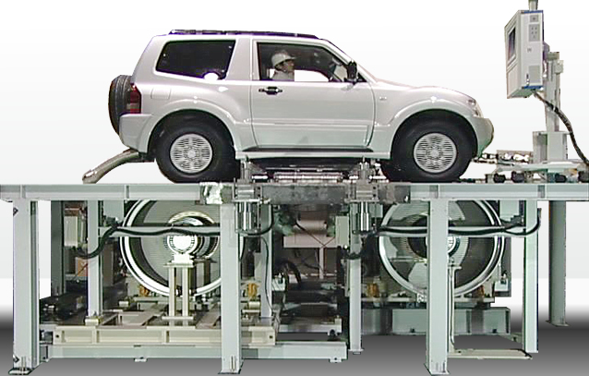
CHASSIS DYNAMOMETER
A chassis dynamometer, is a mechanical device that uses one or more fixed roller assemblies used for a wide variety of vehicle testing and development purposes.
Basic modes:
Tractive force control/Force constant
Speed control/Velocity constant
Road load simulation
Advantages
Engine management
Power control

Slide 15
CRASH TESTING
A crash test is a form of destructive testing usually performed in order to ensure safe design standards in crashworthiness and crash compatibility for various modes of transportation or related systems and components.
Types of Crash Testing:
Frontal-Impact testing
Moderate Overlap tests
Small overlap tests
Data Collection:
Crash tests are conducted under rigorous scientific and safety standards. Each crash test is very expensive so the maximum amount of data must be extracted from each test. Usually, this requires the use of high-speed data-acquisition, at least one triaxial accelerometer.

Slide 16
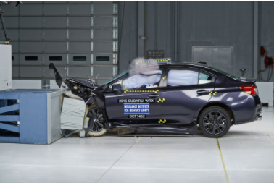
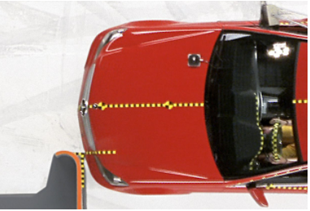
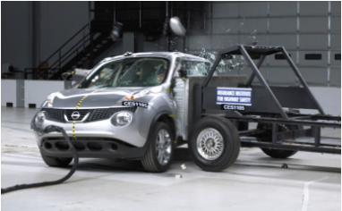
CRASH TESTING

Slide 17
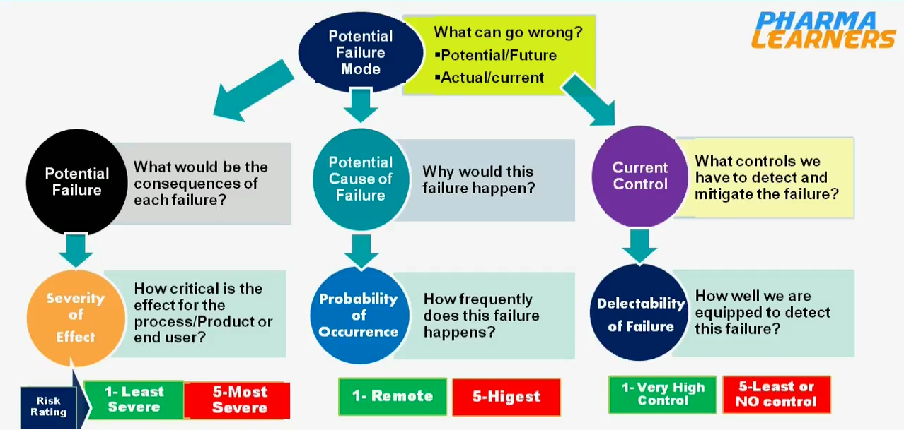
FMEA(FAILURE MODES EFFECTS ANALYSIS) and its Approach
A FMEA Looks at realistic potential problems
It rates the problems with a numerical score
Evaluation has 3 numeric categories
Severity – How bad it is to be
Occurrence – frequency of happening
Detectability – probability to detect that

Slide 18
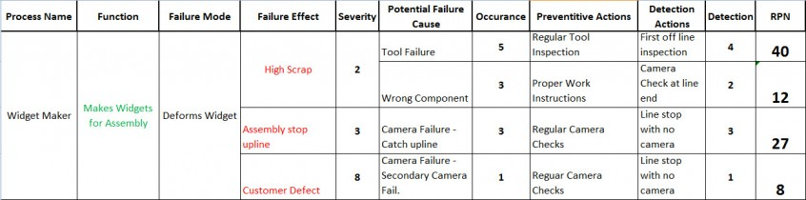
RPN Calculation and reducing the risk
RPN calculation
RPN(Risk Priority Number)= (severity * occurrence *Detectability ).
As RPN is high risk involved is high and vice versa.
RPN reduction
severity cant be changed where occurrence and detectability can be changed.
For multiple failure mode(processes) RPN’s of individual process gets added up.
https://search.yahoo.com/search?fr=mcafee&type=E211US885G91429&p=FMEA+tetsing+on+cars
process | process Failure Mode | Potential effect of failure | severity | current | occurence | RPN

Slide 19
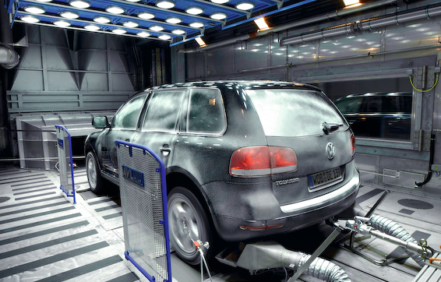
Testing the car in extreme weather conditions
Car should driven in different different weather conditions.
Creating own weather conditions.
Nose teams.
Examining the Hvac system.
[https://www.carwow.co.uk/blog/the-extreme-weather-testing-new-cars-go-through]

Slide 20
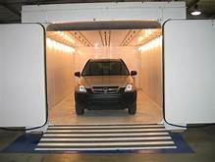
Cosmetic corrosion test method for automotive parts
Cosmetic corrosion - caused due to the
atmospheric conditions
Surface treatment
Cyclic corrosion test
https://img51.chem17.com/1/20130914/635147751957874836375.pdf

Slide 21
ELECTRONIC TESTING

Slide 22
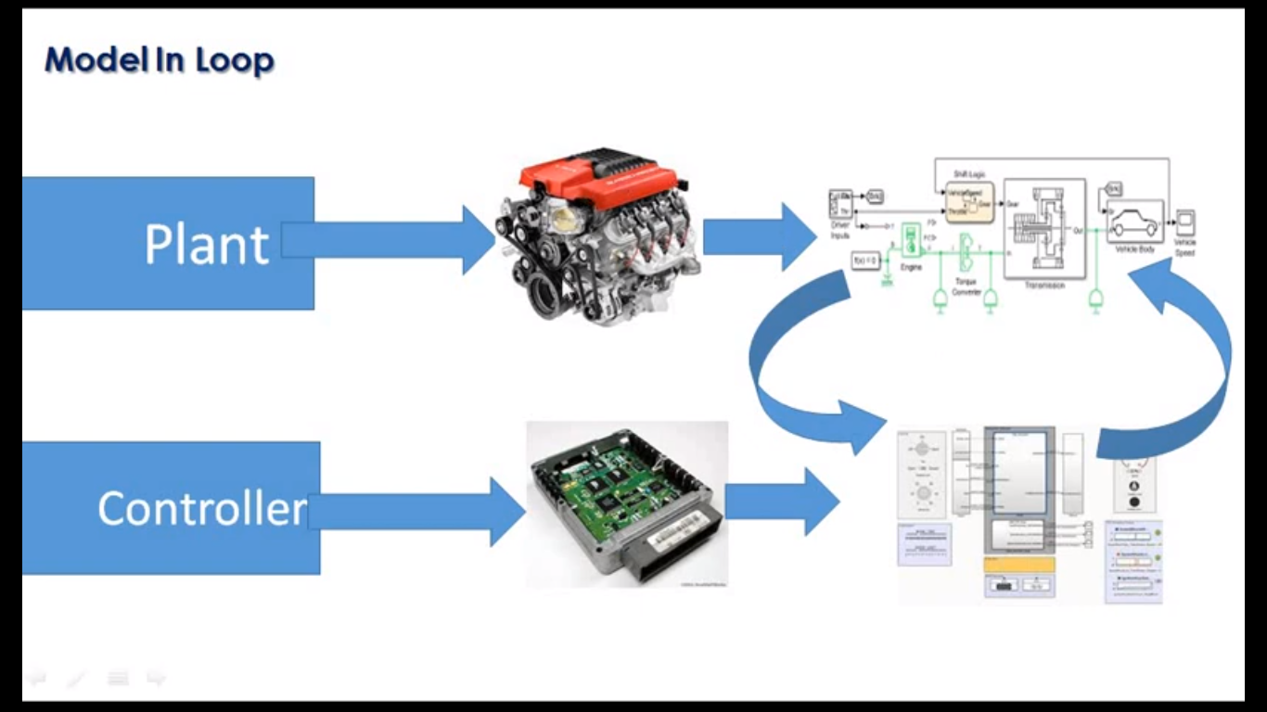
MODEL IN LOOP
Model in the loop, we will create models to abstract the behaviour of a saystem or sub-system to test, simulate and verify that model and its functionbality.
Model: Model is just a software which holds the logic to be implemented in the hardware or vehicle.

Slide 23
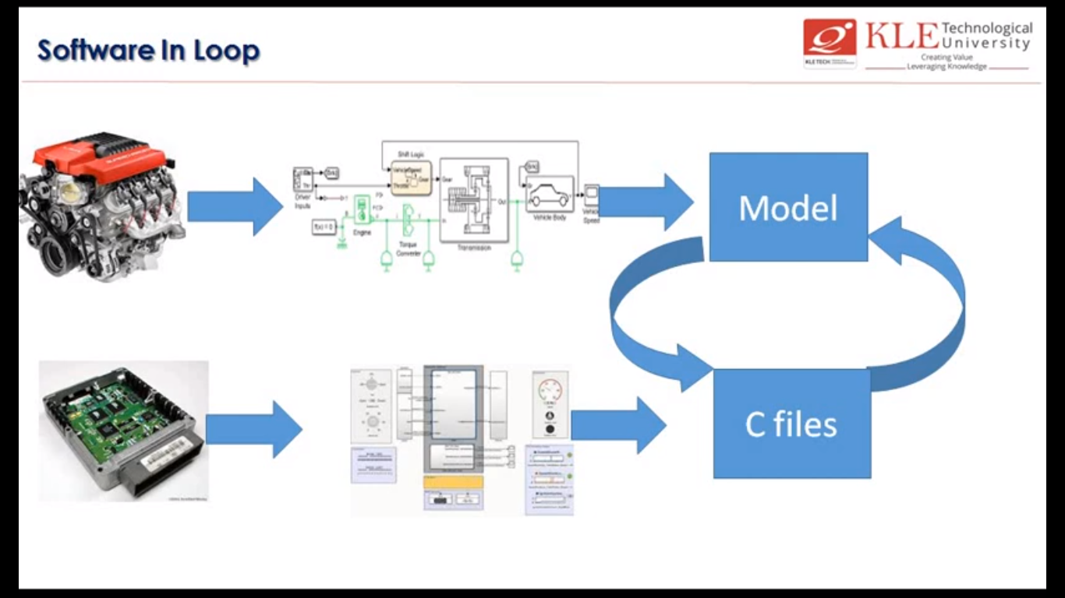
SOFTWARE IN LOOP
This is created by using MIL model
A C file is generated automatically from the simulink software.
SIL is used to simulate the model/controller which we are using to test.

Slide 24
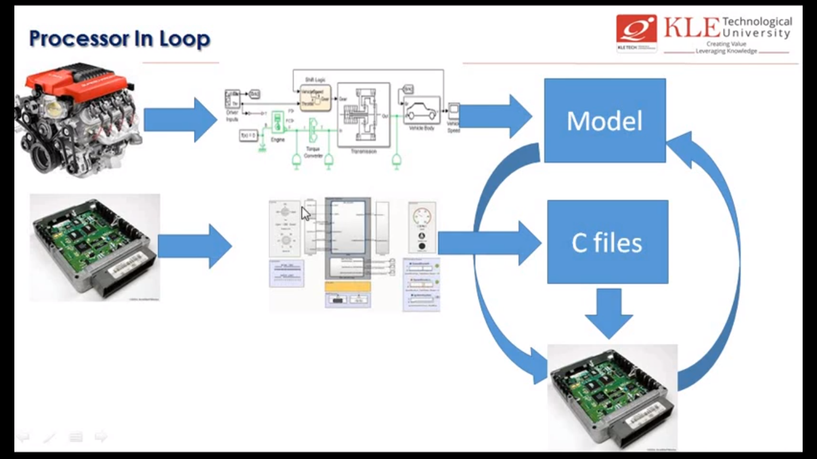
PROCESSOR IN LOOP
Processor in Loop is same as software in loop
.c file is converted into binary or hex file and dumped into the controller.
It is two way communication between simulated model and the controller we connected.

Slide 25
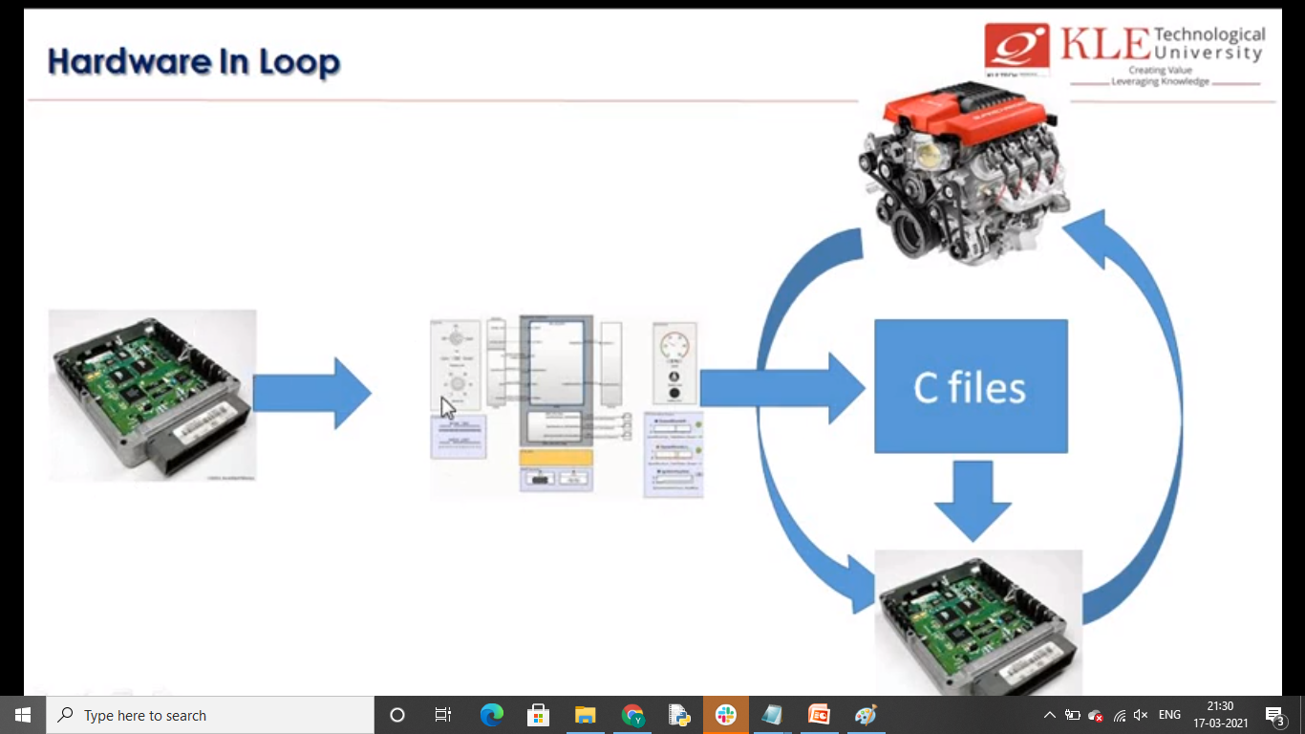
HARDWARE IN LOOP
Hil Testing is a technique where real signals from a controller are connected to a testing system.
In this, real system is not connected.
We will create real world environment for each component using hardware which will simulate highlevel input signals also.

Slide 26
TEAM MEMBERS

Slide 27
TEAM MEMBERS
PS:NO | NAME | CONTRIBUTION
99003725 | Pattamsetti Sai Kalki | FMEA, RPN, Cosmetic corrosion test
99003727 | Vankhadara Naga Shivakumar | Chassis Dynamometer, Crash test
99003729 | Pushkar Antony | Why testing, ISO26262, ASIL, Software testing
99003759 | Rama Subba Reddy | MIL, SIL
99003778 | Jyothi Swaroopa Rani | PIL, HIL

Slide 28
THANK YOU!

